Slide 1

Movie insights project
Wamuyu Gitonga
Lilian Wangui
Natalie Wanjiku
John Njogu
Leejay Mwakereti
Vanessa Sandra

Slide 2
Agenda
Introduction
Business understanding
Data understanding
Methods
Recommendations
Q & A
Conclusion

Slide 3
Introduction
Unlocking new horizons

Slide 4
Overview
The company, looking to diversify its portfolio, has identified the film industry as a potential profitable business opportunity.
In this presentation, we will be reviewing areas in the film industry the company ought to focus on in order to drive profits as they embark on this exciting journey.

Slide 5

Business understanding
Understanding what the industry entails.

Slide 6
Business overview
The film industry business involves understanding how films are developed, financed, produced, distributed and monetized.
In order to make informed decisions on those areas, we are going to explore the types of films currently doing well, and let our findings guide our decisions.
1.
2.
Revenue streams
3.
Key players
4.
Trends and challenges
Film industry value chain
6

Slide 7
Business objectives
Maximize revenue and profitability
Optimize cost-efficiency during production
Achieve strong ROI for investors and stakeholders
Own valuable Intellectual Property
Create original or franchise-worthy content.
Build strong brand and audience loyalty
Establish production labels
Foster community engagement through fan engagements.
Attract and retain talent
Work with reputable actors, directors and writers

Slide 8
Data understanding
Description of the data used in the project

Slide 9

Data
The project used data from 4 different sources, namely;
Internet Movie Database (IMDB)
The Movie DB (TMDB)
Box Office Mojo (BOM)
The Numbers (TN)
f
9

Slide 10
Data description
The IMDB and TMDB databases contain general movie descriptions including their production crews and their biographies, movie ratings, and fan and critical reviews etc.
The TN and BOM datasets contain tracked systematic and algorithmic domestic and foreign box office revenues.
10

Slide 11
Methods
Analysis methods used in the project

Slide 12
Approach
Content analysis
The team examined the contents of the data for pattern identification and, analyzed the behavior of each column over specific periods of time.
Drill-down analysis
We also explored the datasets at an increased level of detail to understand the patterns we observed.
Prescriptive analysis
Post drill-down analysis, we made recommendations based on the analysis findings.
Predictive analysis
The team also made some predictions.

Slide 13

Recommendations
Our future.

Slide 14
Genre recommendations.
We strongly recommend that the company focus on highly profitable genres such as animation, horror, documentary and thriller. We found that these genres have the best returns per dollar and often succeed even with lower production budgets.
We also recommend that the company balance high-profit, high-budget genres such as Adventure, Action, Fantasy, and Sci-Fi. However, we caution that not all blockbuster films succeed therefore we counsel that you consider making only 1/2 blockbuster movies per year while balancing smaller projects.
Lastly, we recommend exploring international markets. Animation, Thriller, and Action genres have strong international appeal. Additionally, Action, Sci-Fi and Fantasy genres have strong franchise potential

Slide 15
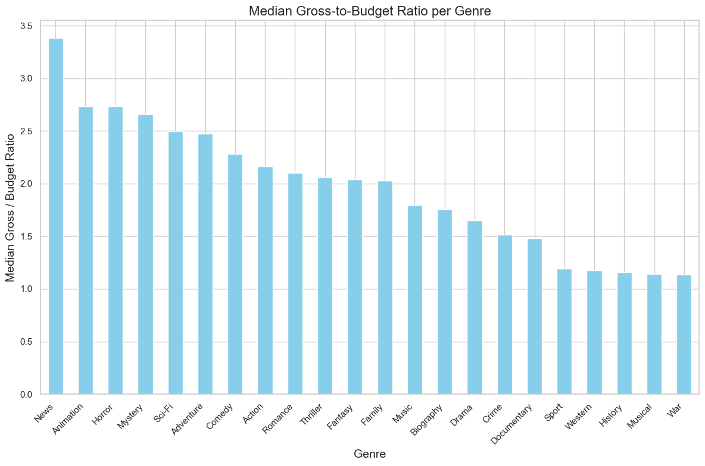
Gross/budget ratios per genre

Slide 16
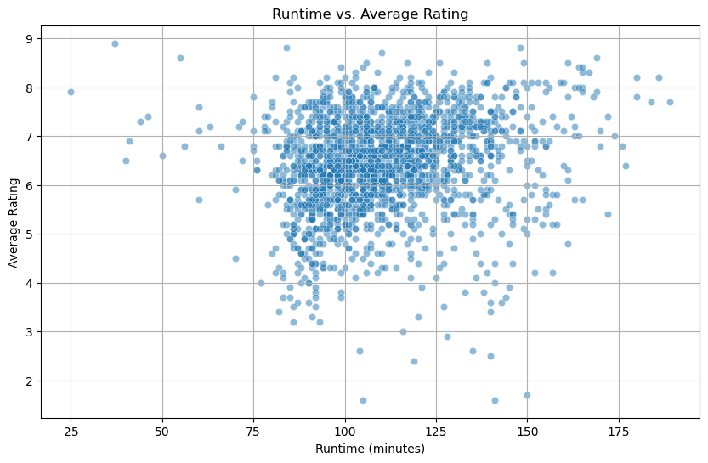
Runtime recommendations
Runtime-ratings relationship.
We recommend that production teams prioritize films with runtimes between 90-120 minutes.
We found that scripts and edits that target this "sweet spot" tend to maximize commercial and critical success.

Slide 17
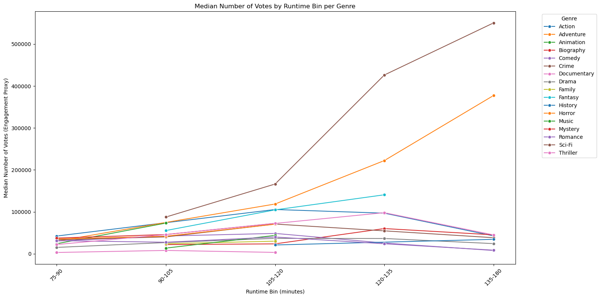
Genre-specific engagements
We recommend the use of genre-specific benchmarks when planning film length to optimize viewer satisfaction and engagement.
For example; Action, Drama, and Sci-Fi genres perform well with longer runtimes.

Slide 18
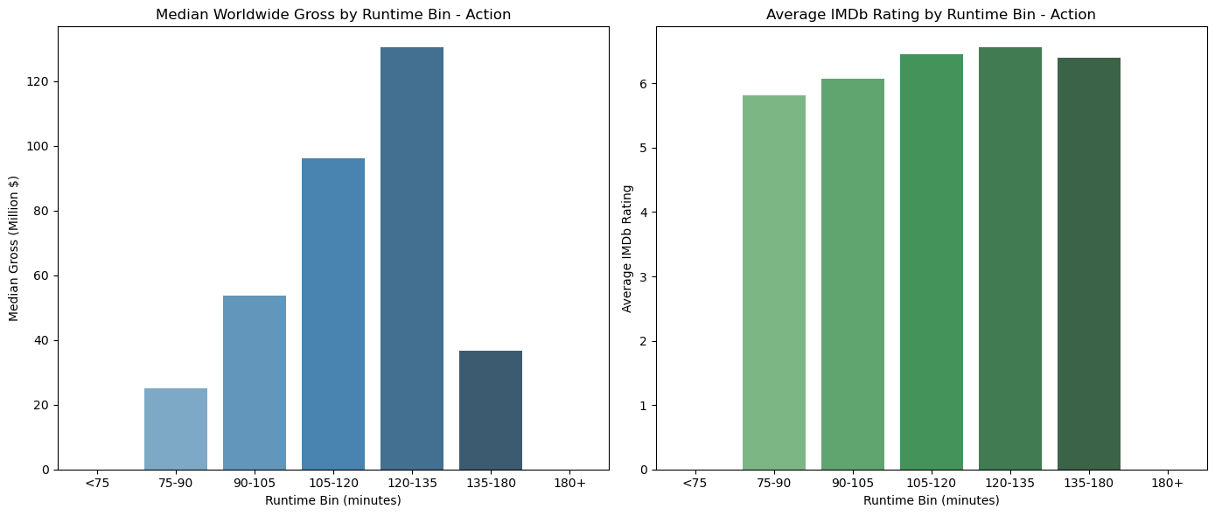
Worldwide gross by runtime and ratings
Encourage teams to avoid runtimes at either extreme (too short or too long) to reduce audience drop-off and improve retention.

Slide 19
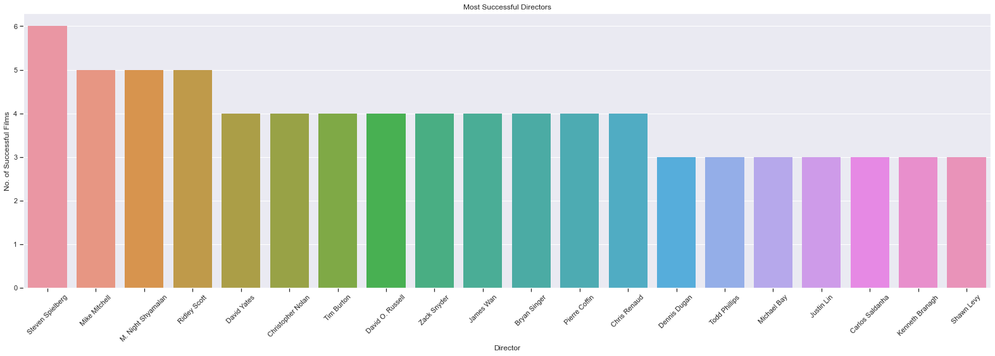
Talent recommendations
Directors.
We recommend directors such as 'Steven Spielberg', 'Mike Mitchell', 'M. Night Shyamalan', 'Ridley Scott’, and 'Tim Burton’ be a part of the company’s production team. These are some of the directors who directed several high-revenue movies.

Slide 20
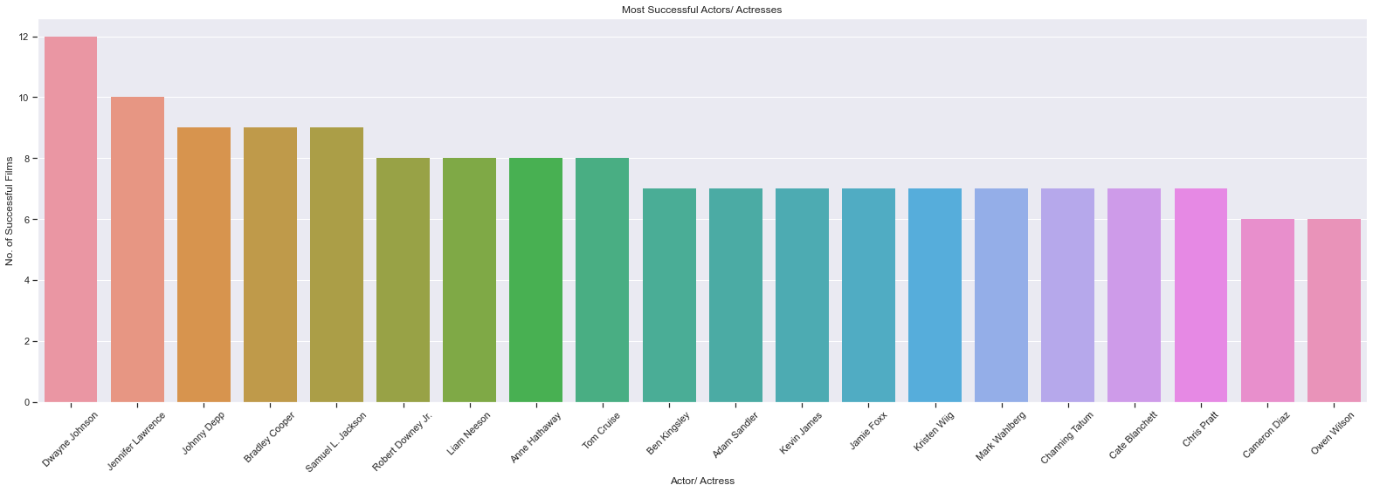
Actors
We recommend hiring and including actors like 'Dwayne Johnson', 'Jennifer Lawrence', 'Johnny Depp', 'Bradley Cooper', 'Samuel L. Jackson', 'Robert Downey Jr.', 'Liam Neeson', 'Anne Hathaway', 'Tom Cruise’, and 'Ben Kingsley’, in the studio’s contents. These are some of the actors who appeared severally in high-earning films therefore cementing our beliefs that they have influence in the film industry.

Slide 21
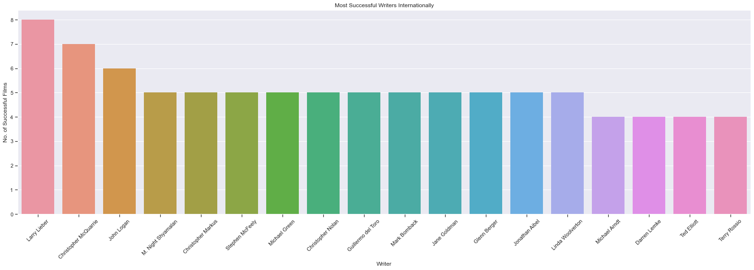
Writers
After careful considerations, the team recommends ‘'Larry Lieber', 'Christopher McQuarrie', 'John Logan', 'M. Night Shyamalan', 'Christopher Markus’, and 'Stephen McFeely’ as the company’s playwright. Our analysis identified them as some of the most brilliant writers in the film industry with several of their movies topping the revenue charts.

Slide 22
Next steps.
Product enhancement. Introduce regular updates and features to enhance product offerings.
Technology integration. Explore emerging technologies for potential integration into our operations.
Collaborative partnerships. Foster collaborations with tech innovators and industry leaders to drive innovation.
Green supply chain
Reduced carbon footprint
Waste reduction
Water conservation
22

Slide 23

Q & A

Slide 24
Thank you
Mirjam Nilsson
mirjam@contoso.com
www.contoso.com

